Slide 1
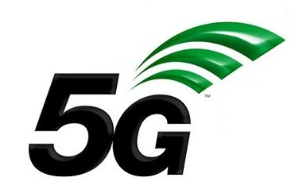

5G NETWORK
Team members:
1. Name: Golam Kibria Tuhin
ID :IT-18015
2. Name: Afra Ibnat Tethye
ID: IT-18055

Slide 2
Questions
What is 5G network?
Who Created 5G technology?
What will enable 5G network?
What new is offered by the 5G applications and devices?
What are the major components of 5G technology?
How does 5G work?

Slide 3
Questions
What are the difference between 4G and 5G network?
Will 5G work on 4G Phones or Devices?
What are the disadvantages of 5G technology?
Which countries have 5G network?

Slide 4
What is 5G network?
In telecommunications, 5G is the fifth generation technology standard for broadband cellular networks , which cellular phone companies began deploying worldwide in 2019, and is the planned successor to the 4G networks which proved connectivity to most current cell phones.

Slide 5
Who created 5G technology?
AT&T had deployed 5G in 21 cities and claimed the 5G network would be deployed in 30 states by the end of 2019. The 5G standards are being jointly developed by the International Telecommunication Union (ITU) and 3GPP. The standard written by the ITU called the IMT-2020.

Slide 6
What will enable 5G network?
5G will enable instantaneous connectivity to billions of devices , the Internet of Things (IoT) and a truly connected world. 5G will provide the speed, low latency and connectivity to enable a new generation of applications, services and business opportunities that have not been seen before.

Slide 7
What new is offered by 5G application?
It is expected that 5G will offer mobile internet speeds of more than 10 gigabits per second (Gbps), approximately a hundred times faster than 4G.
The latency will be less than a millisecond with 5G network.

Slide 8
What are the major components of 5G technology?
For ultra fast mobile broadband, low latency and ultra reliable network to support all future applications, existing technologies have many limitations. 5G will be using new network terminologies, high bandwidth spectrum, complex modulation schemes and algorithms with advanced hardware modules.

Slide 9
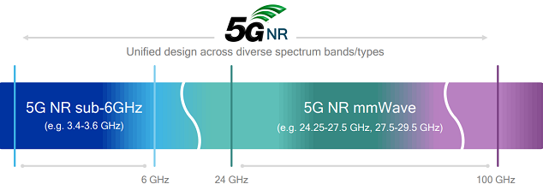
What are the major components of 5g technology?
Spectrum – 5G NR:
5G New Radio is a new spectrum that will be utilized in 5G applications to support much higher data rate. Millimeter wave spectrum from 24 GHz to 90 GHz and unlicensed sub-6GHz spectrum will be used in first generation of 5G deployments of mobile broadband.

Slide 10
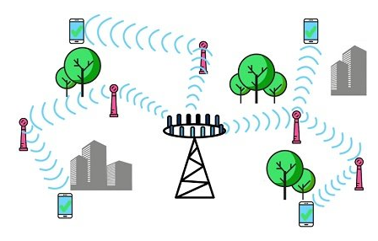
What are the major components of 5G technology?
Small cells and pico-cells:
Small cells are low power base stations used in LTE advanced versions and 5G technology to power devices in a smaller geographical area like few hundred meters up to 2 KM radius. Smalls cells will be using millimeter waves to transmit and receive data. Millimeter waves are not suitable for long distance communication due to higher distortion from atmosphere and obstacles.

Slide 11
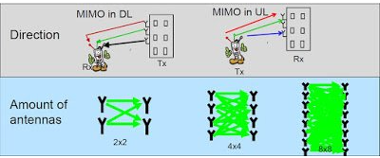
What are the major components of 5G technology?
Massive MIMO:
MIMO (Multiple Input Multiple Output) concept is used to increase data rate with addition of antenna for transmitting and receiving signals. Large number of miniature sized antenna arrays are used in 5G technology. User devices also will be capable of receiving and sending data using multiple antennas integrated in mobile devices.

Slide 12
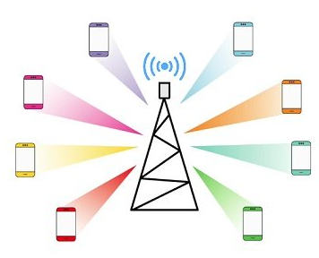
What are the major components of 5G technology?
Beamforming:
Beamforming is another smart technology
concept to efficiently transmit data to user
devices. Precise location of the user
device is continuously tracked using
advanced software algorithms and base
stations transmit signals only in the
direction of the user’s location.
Conventional base stations transmit
data in multiple directions which causes
higher power consumption and unnecessary resource utilization.

Slide 13
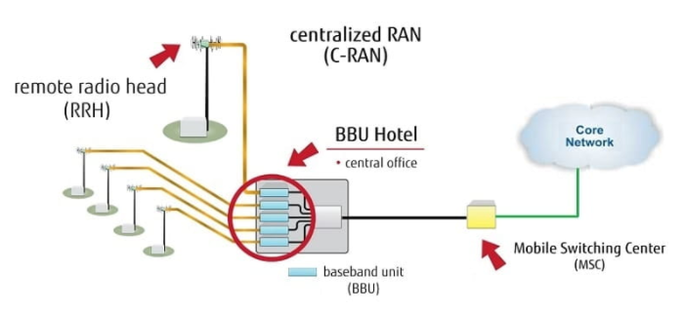
What are the major components of 5G technology?
Full duplex mode of transmission:
In conventional
transmission
method, one
single mode of
transmission is
possible in
either direction.
In full duplex
mode, high
speed switches are used to control data transfer in each direction by efficiently switching one at a time and fully utilizing the existing spectrum. The same frequency band can be used for transmission and receiving mode of operation.

Slide 14
How does 5G work?
Initially integrate 5G networks with existing 4G networks to provide a continuous connection. A mobile network has two main components, the ‘Radio Access Network’ and the ‘Core Network:
The Radio Access Network :
The Radio Access Network consists of various types of facilities including small cells, towers, masts and dedicated in-building and home systems that connect mobile users and wireless devices to the main core network.
The Core Network :
The core Network is the mobile exchange and data network that manages all of the mobile voice, data and internet connections. For 5G, the ‘core network’ is being redesigned to better integrate with the internet and cloud based services and also includes distributed servers across the network improving response times (reducing latency).

Slide 15
What are the difference between 4G and 5G networks?
5G is expected to be nearly 100 times faster than 4G.
Those speeds are possible because most 5G networks are built on super-high-frequency airwaves, also known as high-band spectrum.
The higher frequencies can transmit much more data, much faster than on 4G.

Slide 16
Will 5G work on 4G phone or devices?
Yes. If we are among the 86 percent of the population who are concerned that the recent rollouts of 5G networks will make your 4G cell phone obsolete, there's no need to worry. 4G phones still work on a 5G network, they just won't get that coveted 5G speed.

Slide 17
What are the disadvantages of 5G technology?
Obstructions can impact connectivity. The range of 5G connectivity is not great as the frequency waves are only able to travel a short distance.
Initial costs for rollout are high. ...
Limitations of rural access. ...
Battery drain on devices. ...
Upload speeds don't match download speeds. ...
Detracting from the aesthetics.

Slide 18
Which countries have 5G network?
South Korea , China and the United states are the countries that lead the world in building and deploying 5G technology.

